Slide 1
PM2.5 Prediction with Machine Learning
Presented by
Kyi Thin Nu (st124087)
Thongtong Eamsaard (st123300)
Group 7
Image sources: https://www.bangkokpost.com/life/social-and-lifestyle/2578139/thailand-clean-air-network-needs-you
Notes:
20-25 minutes presentation
10 minutes for demo of the code.

Slide 2




Table of Contents
01 Introduction & Problem Statement
02 Related Works
03 Methodology
04 Results
05 Conclusions & Future Works

Slide 3

Introduction & Problem Statement
01
02
03
04
05

Slide 4
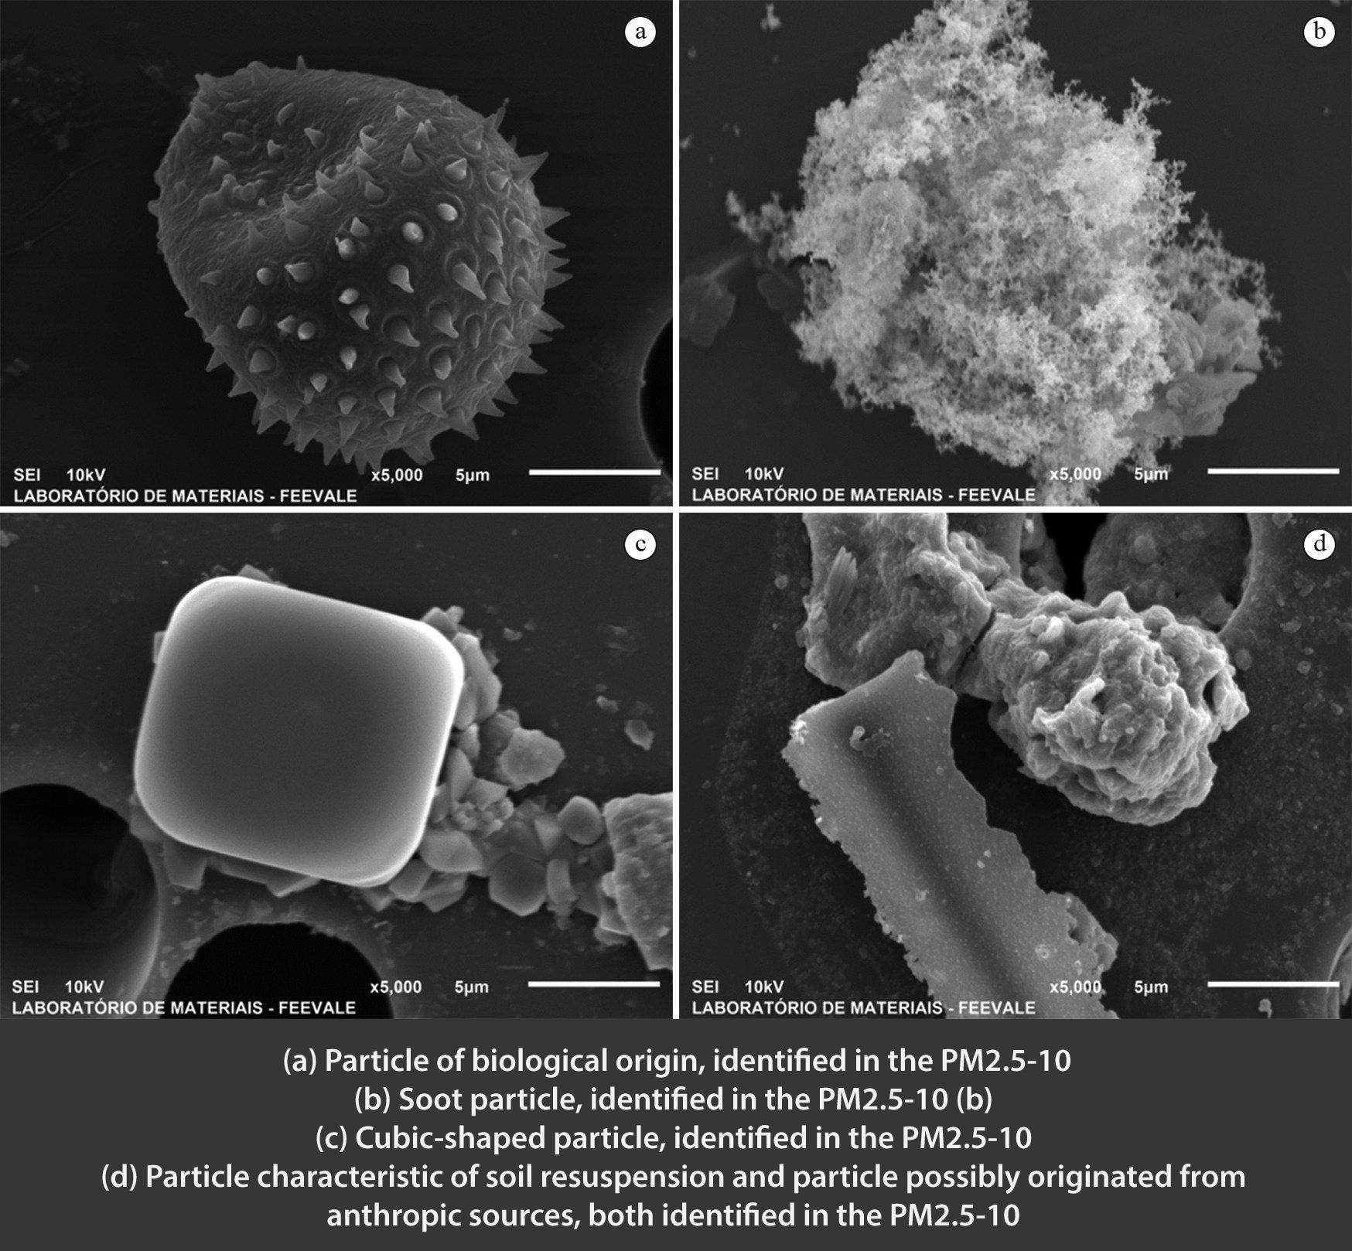

What is PM2.5 ?
01
Particulate Matter or PM2.5
refers to tiny airborne particles or droplets with a diameter of 2.5 micrometers or smaller.
02
03
04
05
2.5 microns
Image Source: https://www.devex.com/news/inside-thailand-s-tussle-with-toxic-smog-104836,
https://journals.sagepub.com/doi/abs/10.1177/1420326X04059280?journalCode=ibeb

Slide 5
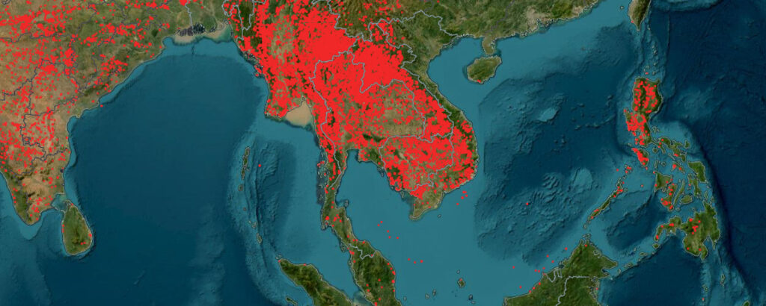
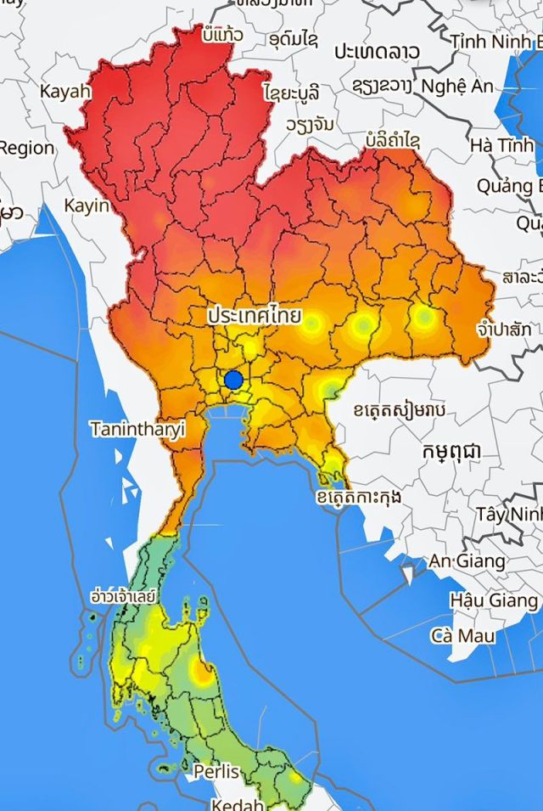
PM2.5 Perspective
01
PM2.5: Global Perspective
helps nations collaborate in addressing transboundary air pollution
sharing information to mitigate the impact of airborne particles on a global scale.
02
03
04
Image Source: https://bkktribune.com/the-hard-lessons-of-pm2-5-haze/
05
PM2.5: Local Perspective
helps individuals make informed decisions about outdoor activities
it assists policymakers in implementing measures to improve air quality and protect public health.
Image Source: bkktribune.com/the-hard-lessons-of-pm2-5-haze

Slide 6
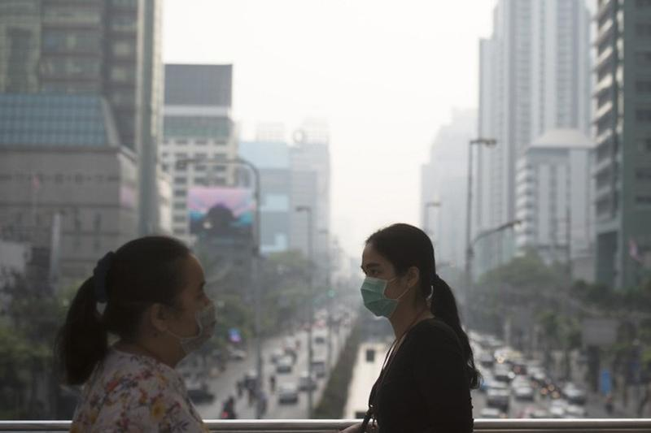
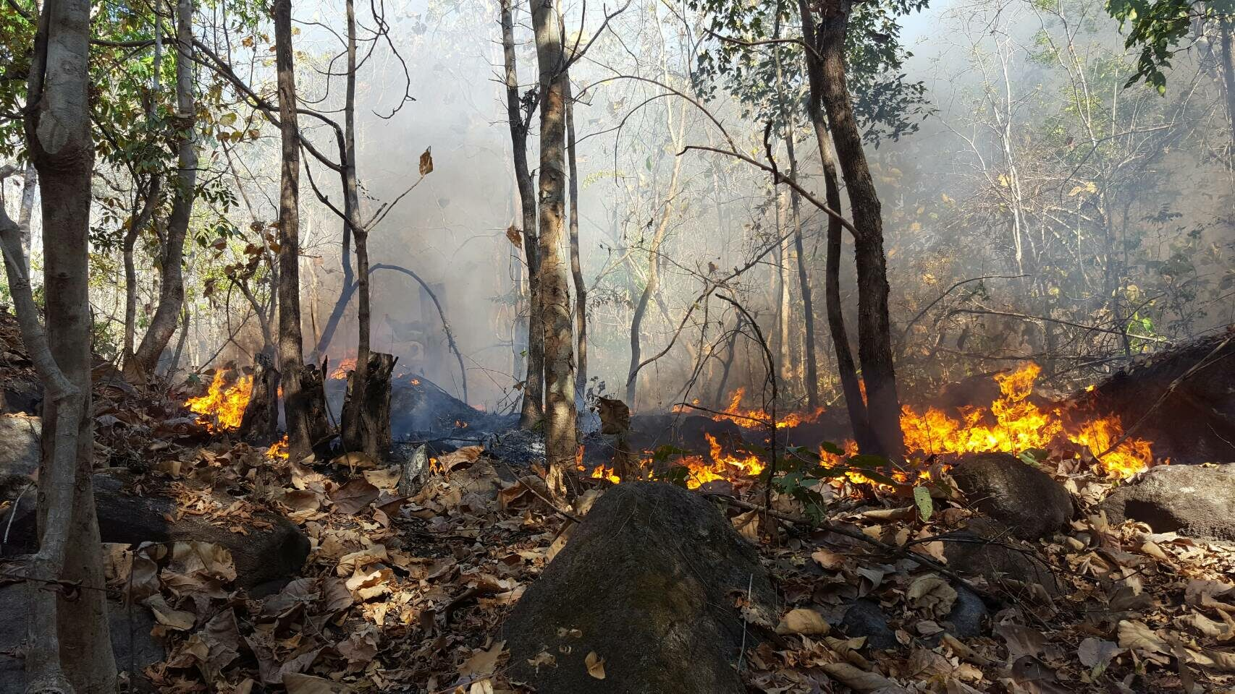
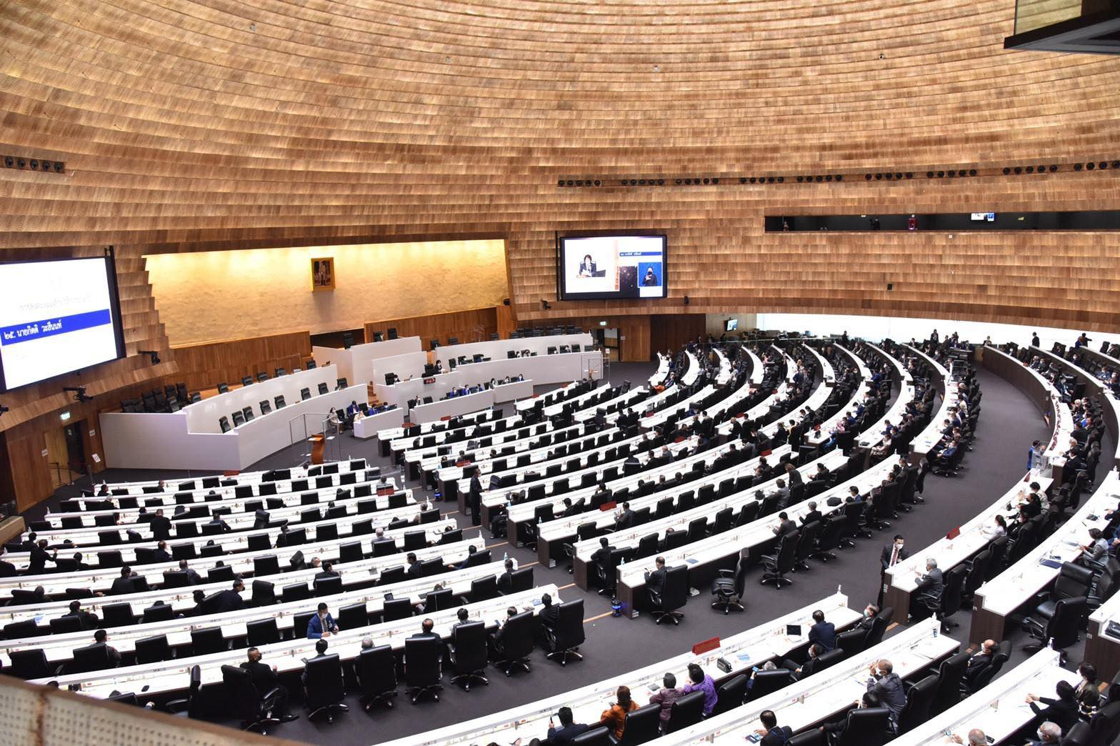


Why PM2.5 is important ?
01
02
Protecting Public Health Reduce Source of PM2.5
Help Announce Policy and Regulation Raise Awareness and Education
03
04
05
Image Source: https://home.maefahluang.org/pm2_5_neweducatation

Slide 7
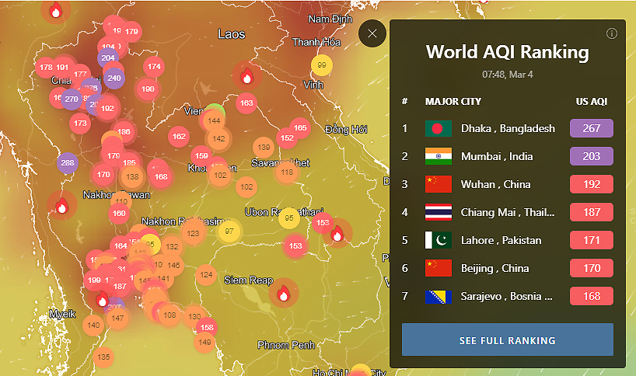
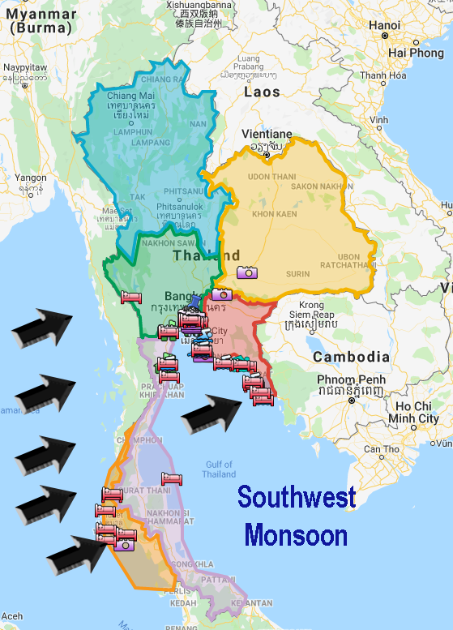
Problem Statement
01
To predict the PM2.5 values based on given weather conditions and trends of the PM2.5, Correlations between weather parameters and PM2.5, Weather effects (wind speed and temperature) on PM2.5
02
03
04
05
Image Source: https://stats.stackexchange.com/questions/198181/interpreting-temporal-trends-and-selecting-predictors-in-regression-models,
https://www.bangkok-travel-ideas.com/weather-in-thailand.html, https://www.bangkokpost.com/thailand/general/2520020/solutions-sought-as-north-ravaged-by-toxic-pm2-5

Slide 8
Literature Review
01
02
03
04
05

Slide 9
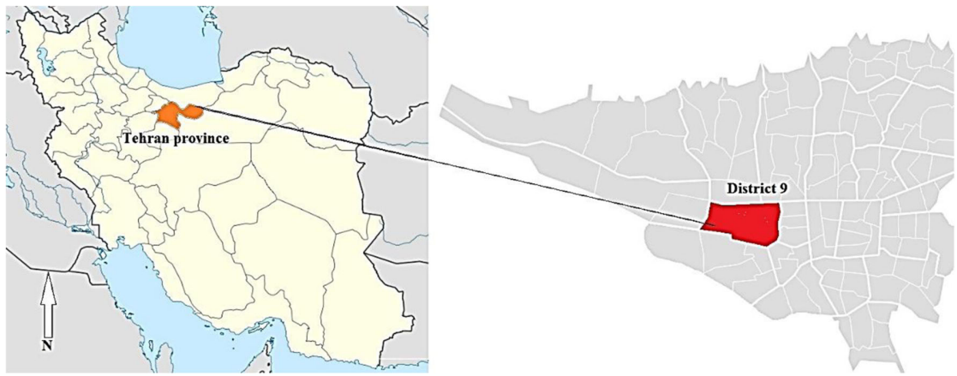

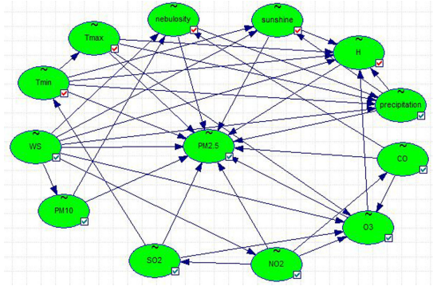
Literature Review
01
02
proposed decision trees (DT), Bayesian Network (BN), and support vector machine (SVM). Using the data for over three periods,
PM10, NO2, SO2, and O3 are critical factors for PM2.5
Our work will include location, wind direction and wind speed.
03
04
05
Image Source: Mehdipour V., Stevenson D.S., Memarianfard M. et al, “Comparing different methods for statistical modeling of particulate matter in Tehran, Iran”, Air Quality Atmosphere Health 11, pp.1155—1165 (2018), https://doi.org/10.1007/s11869-018-0615-z

Slide 10
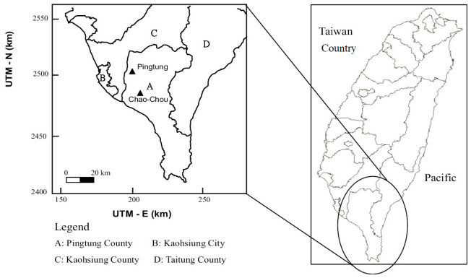
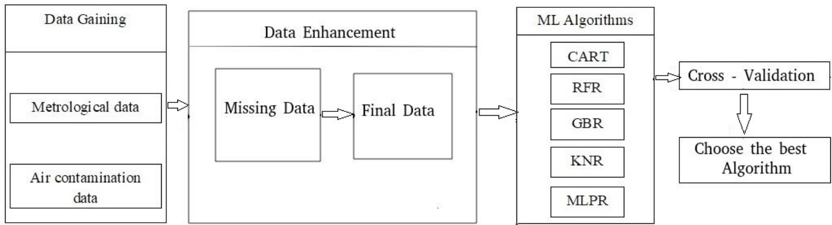
Literature Review
01
Taiwan Air Quality Monitoring data set.
The model they used are random forest regressor (RFR), gradient boosting regressor GBR), k neighbors regressor (KNR), MLP regressor (MLPR), and decision tree regressor CART.
To select the best model, they used cross-validation and determined that gradient boosting regressor model is better in forecasting air pollution in TAQMN data.
02
03
04
05
Image Source: Doreswamy, Harishkumar K. S., Yogesh K.M. and Ibrahim Gad. “Forecasting Air Pollution Particulate Matter (PM2.5) Using Machine Learning Regression Models”. Procedia Computer Science. vol. 171. 2020. pp. 2057–2066. https://www.sciencedirect.com/science/article/pii/S1877050920312060

Slide 11
Methodology
01
02
03
04
05

Slide 12

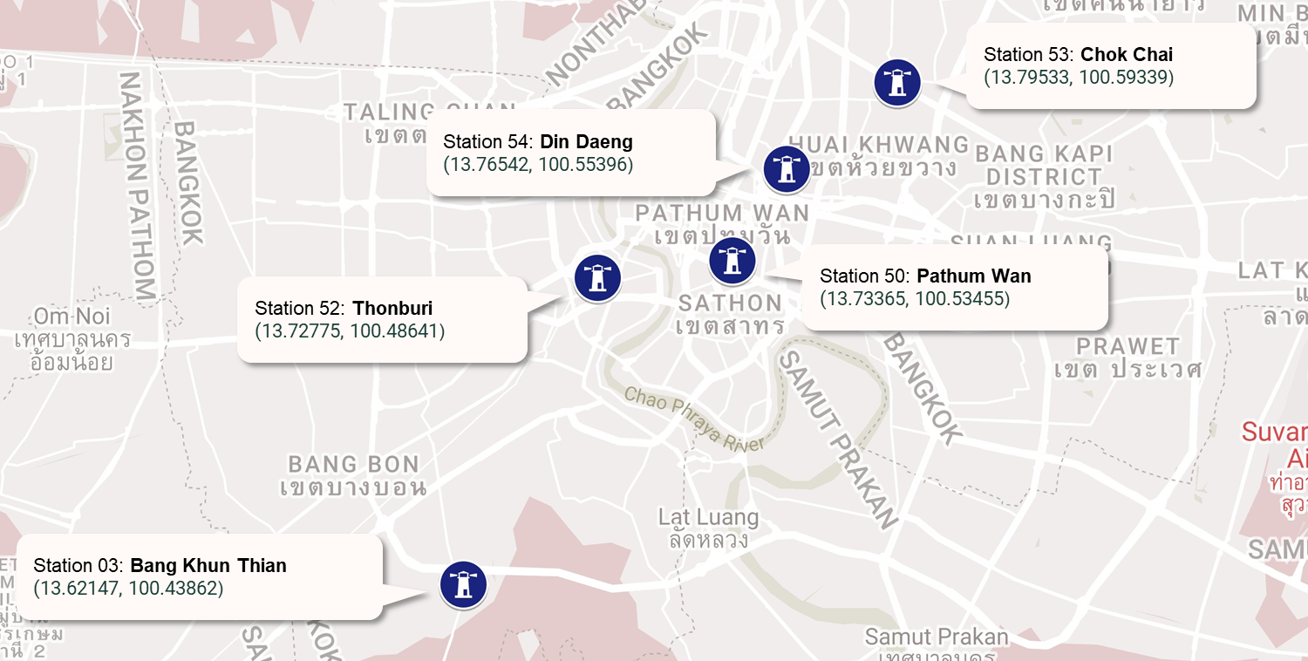


Data Acquisition
Clean
Data
EDA
Preprocess
Select
Model
Train
Evaluate
Deploy
01
02
03
04
05
Thanks to professor for valued data set
Image Source: https://www.google.co.th › maps

Slide 13

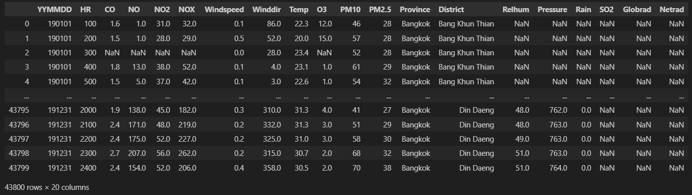
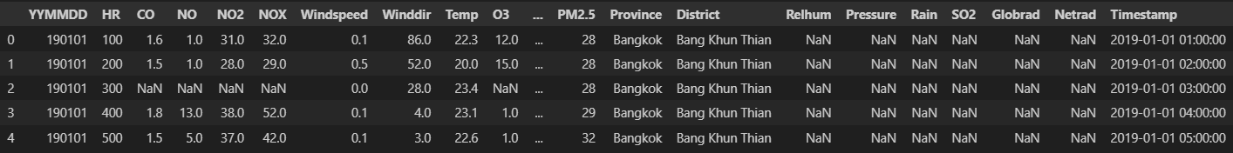
Data Acquisition
Clean
Data
EDA
Preprocess
Select
Model
Train
Evaluate
Deploy
Drop 2nd header not necessary
01
02
Rename header + Add Province column because we have 5 stations
03
Merge all 5 stations -> single DataFrame
04
05
8760 rows × 20 columns × 5
43800 rows × 20 columns
Datetime formatting
(and drop YYMMDD and HR)
For EDA and trends analysis
Image Source:

Slide 14
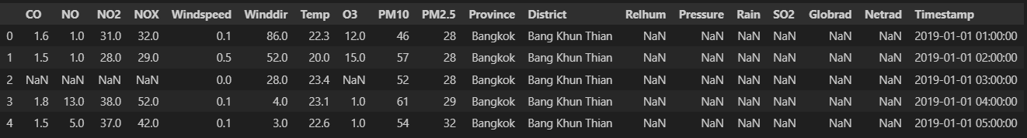
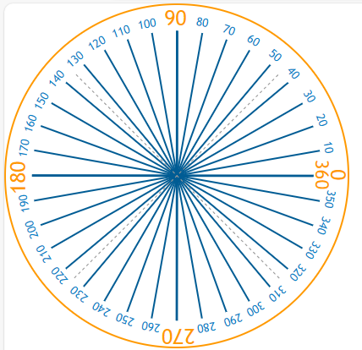
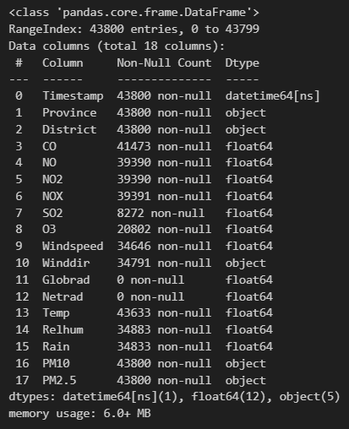
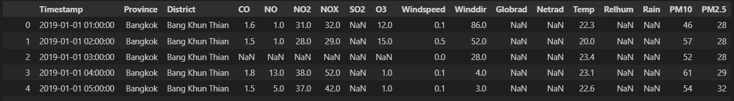
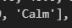
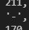
Data Acquisition
Clean
Data
EDA
Preprocess
Select
Model
Train
Evaluate
Deploy
Reorder the columns
making it more readable and more manageable (move target variable to the end)
01
02
03
04
05
predictor
target
Replace string values in numerical columns
‘Calm’ in Winddir, no direction in degree recorded. So, we replace it as NaN (because same result as sensor can’t record data)
‘-’ in PM10 & PM2.5, no value recorded. So, we replace it as NaN (because same result as sensor can’t record data)
Image Source: https://www.mathsisfun.com/geometry/images/degrees-360.svg

Slide 15
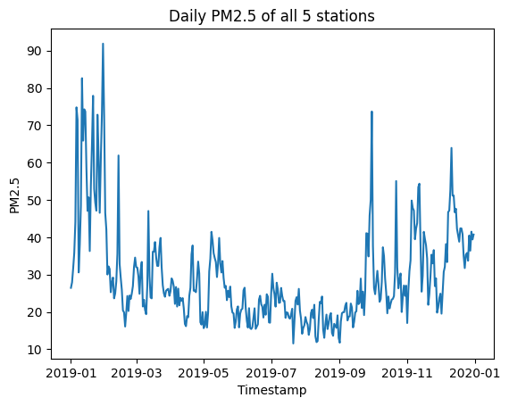
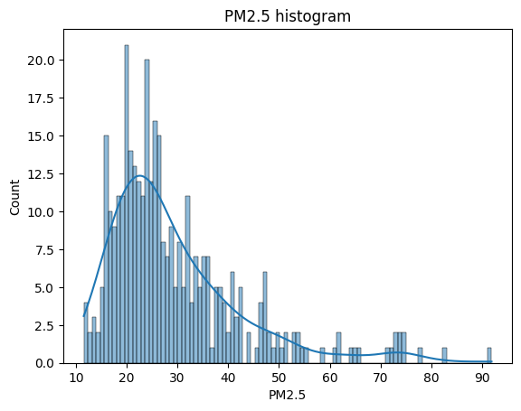
Data Acquisition
Clean
Data
EDA
Preprocess
Select
Model
Train
Evaluate
Deploy
PM2.5 (all stations)
plotting to see the trend of average PM2.5 daily in all 5 stations.
PM2.5 is quite high in the first two months. Then it drops dramatically at each its lowest in September. Finally, it starts rising again up until the end of December.
01
02
03
04
05
Most in these range
Image Source:

Slide 16
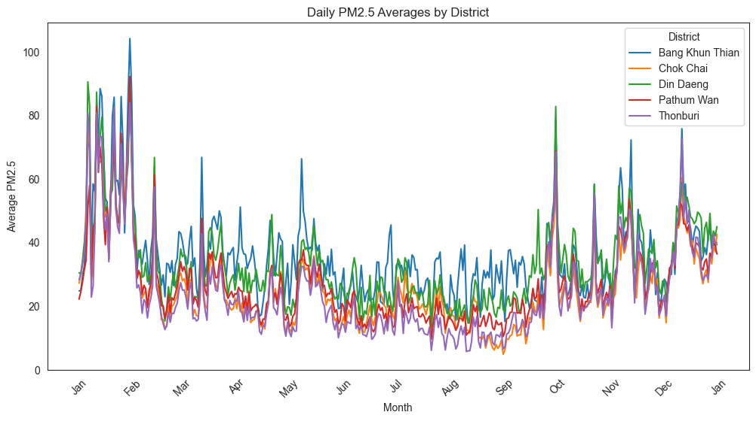
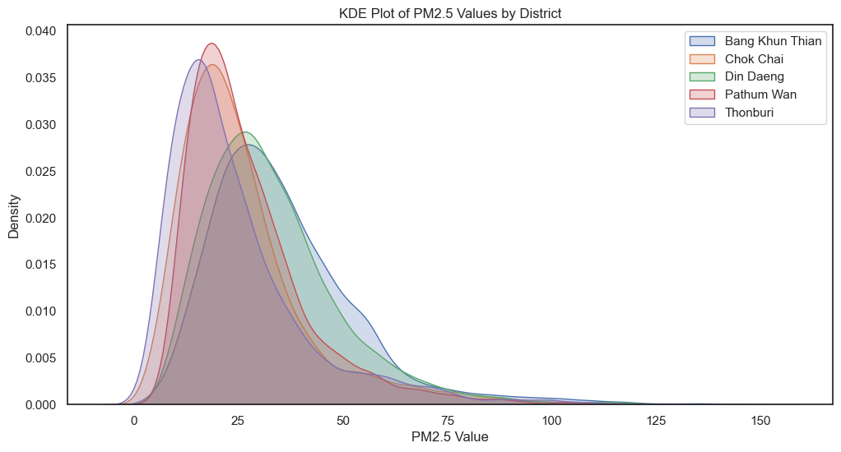
Data Acquisition
Clean
Data
EDA
Preprocess
Select
Model
Train
Evaluate
Deploy
PM2.5 (individual)
we compared PM2.5 from each station that are relatively in the same province so PM2.5 should be in the same trends.
However, in kde plot, it shows that stations has 2 different distributions of the PM2.5 values. Bang Khun Thian is similar with Din Daeng. The other group is Chok Chai, Pathum Wan, and Thonburi.
01
02
03
04
05
Image Source:

Slide 17
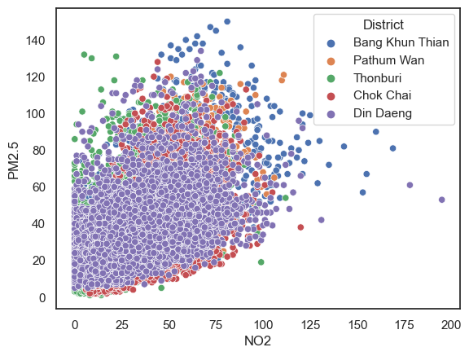
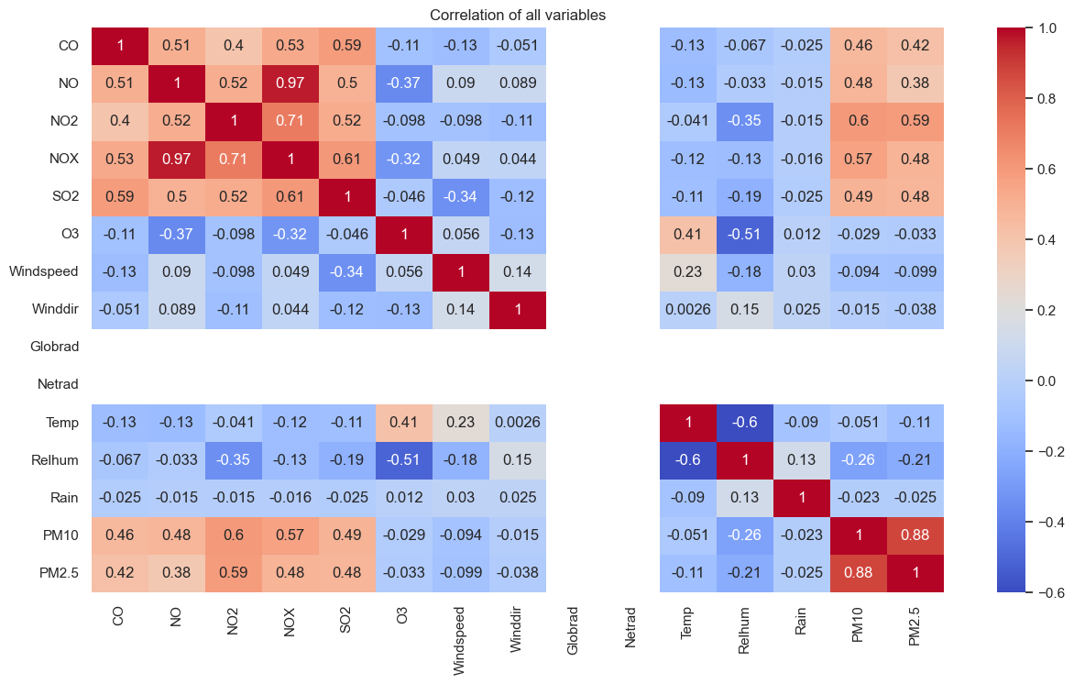
Data Acquisition
Clean
Data
EDA
Preprocess
Select
Model
Train
Evaluate
Deploy
PM2.5 – NO2
If NO2 increases, it tends to increase the minimum PM2.5 value boundary. This indicates that NO2 has some effects to PM2.5.
01
02
03
04
05
Correlation Heat Map
CO, NO, NO2, NOX, SO2, and PM10 have potential to be the predictor for PM2.5 as target variable.
Image Source:

Slide 18
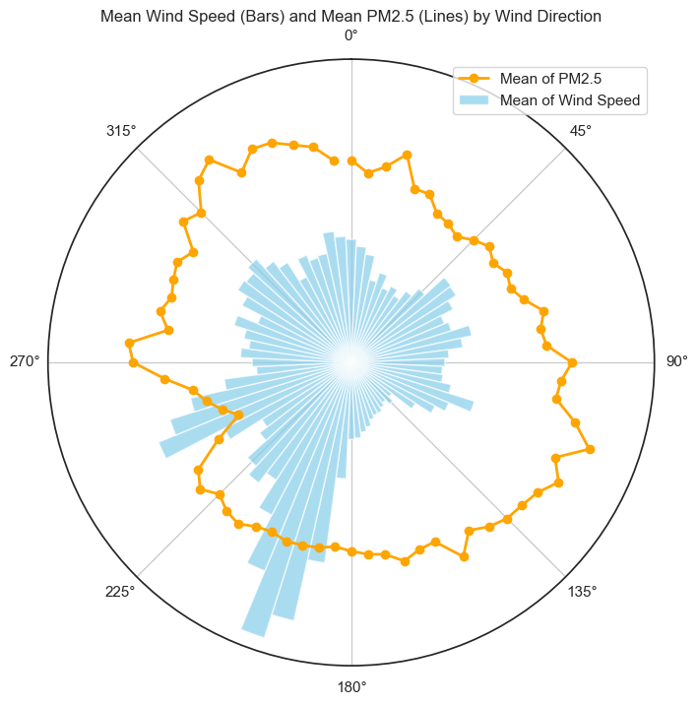
Data Acquisition
Clean
Data
EDA
Preprocess
Select
Model
Train
Evaluate
Deploy
Windspeed – Wind Direction – PM2.5
Most wind coming from Southwest (SW) direction (180 – 270 degree)
Wind direction and windspeed not directly main source of PM2.5. (Not the main carrier that bring PM2.5 to Bangkok.
01
02
03
04
05
Image Source:

Slide 19
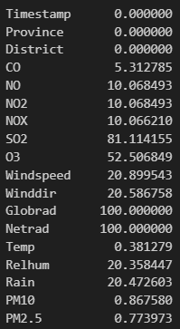
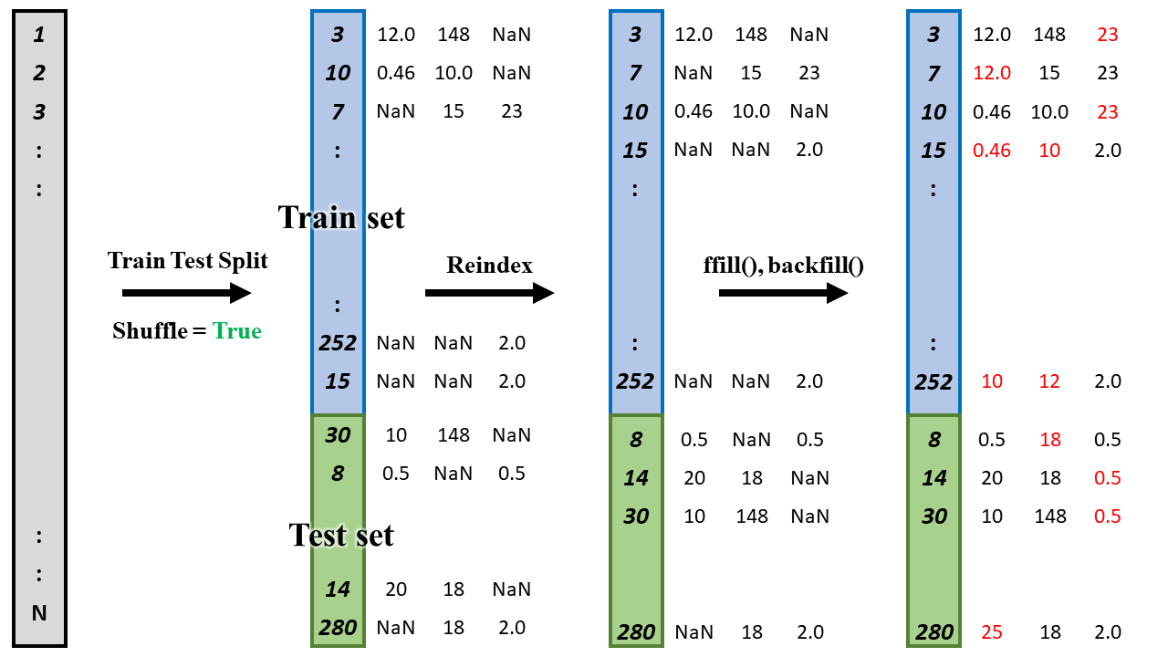
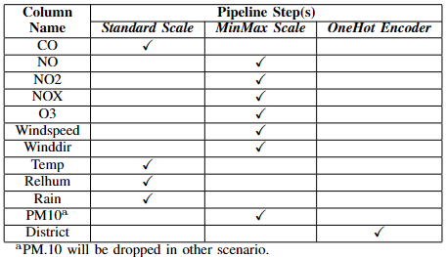
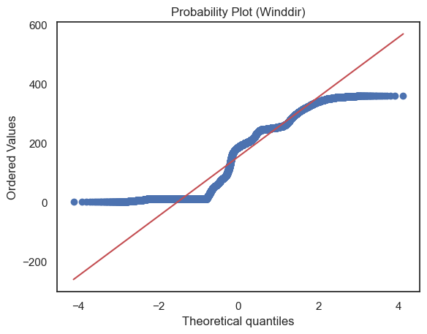
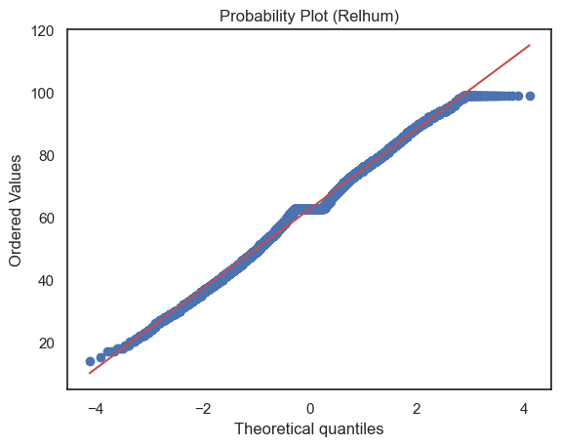
Data Acquisition
Clean
Data
EDA
Preprocess
Select
Model
Train
Evaluate
Deploy
01
Remove columns
Globrad and Netrad 100 % are NaN (Not a Number)
SO2 less than 20 % entries
Province single unique value, Bangkok.
Timestamp will also be dropped time-independent.
02
03
Train-test Split with 80 : 20 train-test ratio
04
Imputation
Reindex then forward fill and backward fill (sensor data)
05
Scale and Encode into pipeline
Image Source:

Slide 20

Data Acquisition
Clean
Data
EDA
Preprocess
Select
Model
Train
Evaluate
Deploy
01
02
03
Cross Validation
K-Fold = 5
GridSearchCV
K-Fold = 10
04
Select Model
Tune Hyper-params
Best Model, Best hyper-params
05
10 Models
Linear Regression
Ridge Regression
Lasso Regression
Gradient Boosting Regression
Histogram-based Gradient Boosting Regression Tree
Support Vector Regression (SVR)
K Neighbor Regression
Decision Tree Regression
Random Forest Regression
AdaBoost Regression
Best Model
Image Source: https://www.shutterstock.com/search/tightening-bolts,

Slide 21
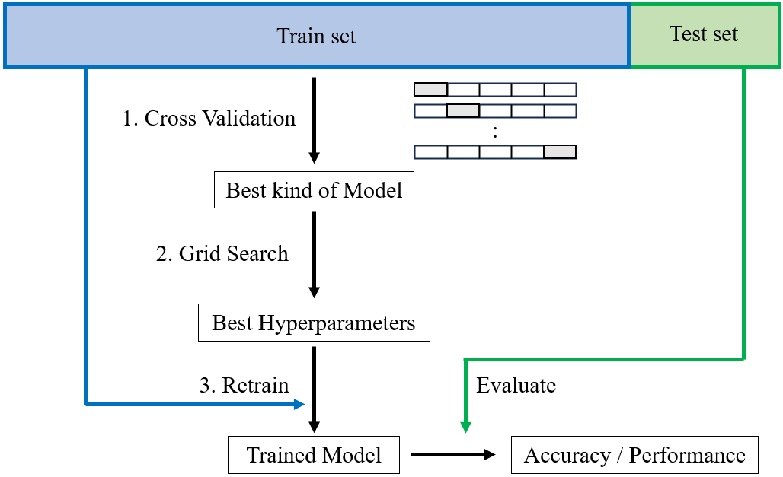
Data Acquisition
Clean
Data
EDA
Preprocess
Select
Model
Train
Evaluate
Deploy
01
02
03
04
05
Best Model, best hyper-params
Use R2 score
Image Source:

Slide 22
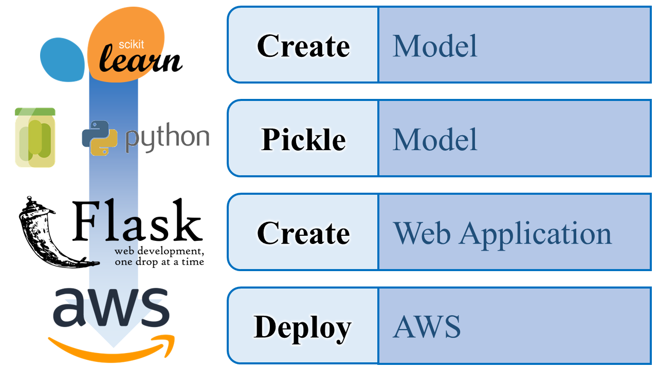
Data Acquisition
Clean
Data
EDA
Preprocess
Select
Model
Train
Evaluate
Deploy
01
02
03
04
05
Image Source:

Slide 23
Results
01
02
03
04
05

Slide 24
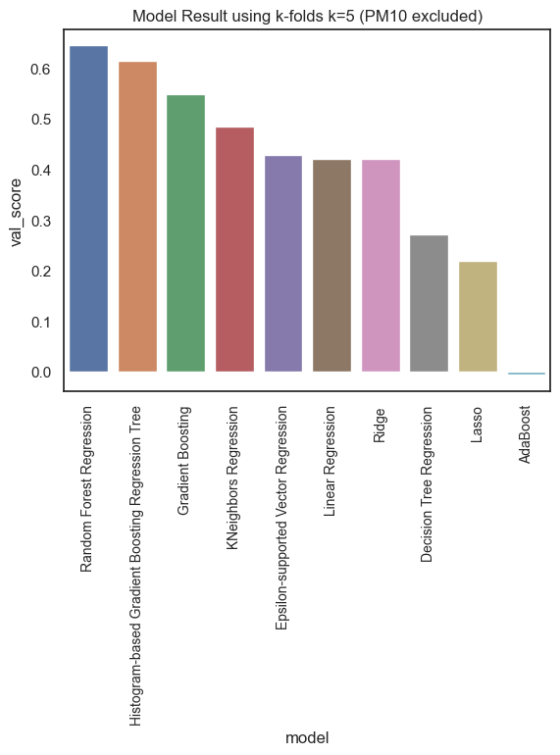
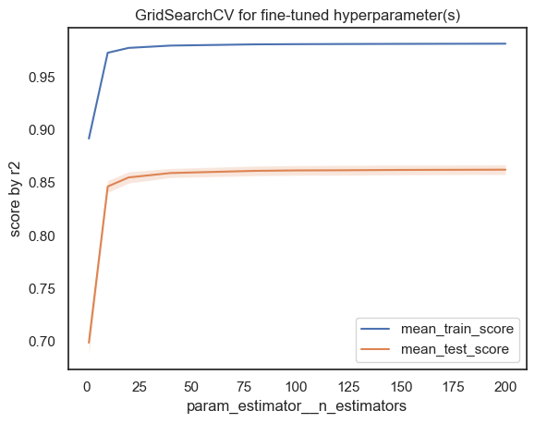
Results
01
Select Model and Hyper-parameter(s) Tuning
Model Selection
02
03
Hyper-parameter tuning (n_estimators = 40)
04
05
Long process time
Easy to overfit
Random Forest Regression
Image Source:

Slide 25
Results
01
Create Pipeline
02
03
Pipeline
preprocessor: ColumnTransformer
04
StandardScaler
MinMaxScaler
OneHotEncoder
remainder
05
CO Temp Relhum Rain
NO NO2 NOX O3 Windspeed Winddir
district
passthrough
RandomForestRegressor
Image Source:

Slide 26
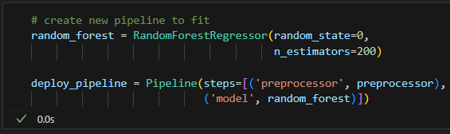
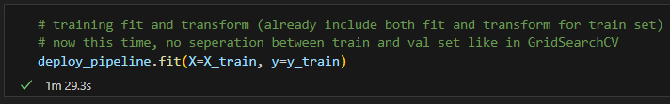
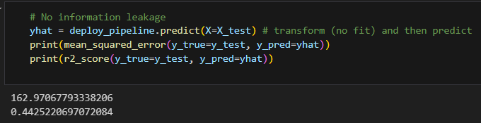
Results
01
Train and Evaluation
02
03
Training
04
Val R2 score = 0.648
(64.8 % that model can explained)
05
Evaluation
Test R2 score = 0.443
Image Source:

Slide 27
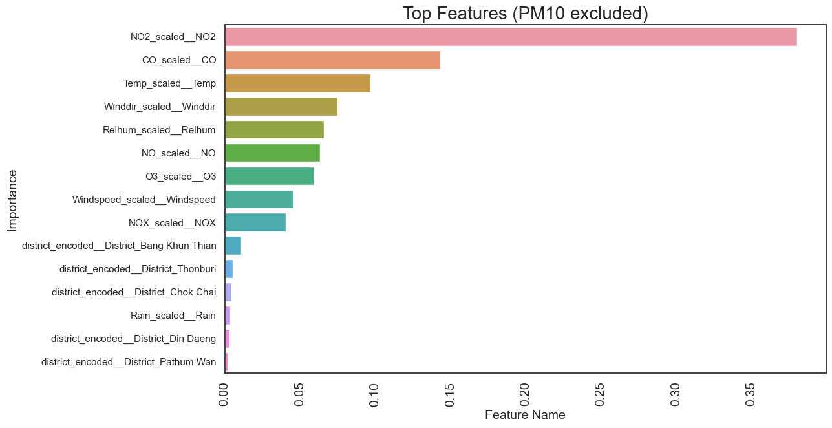
Results
01
Evaluation
02
Top Features
03
04
05
Image Source:

Slide 28
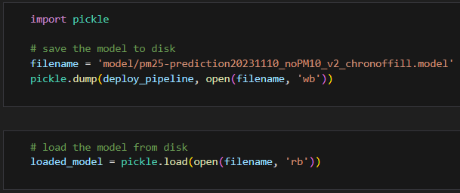
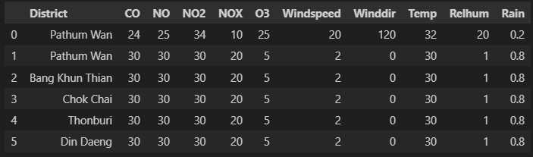
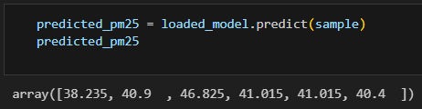
Results
01
Create and Pickle the Model
02
03
Sample DataFrame
04
05
Image Source:

Slide 29
Results
01
Create and Pickle the Model
02
03
Sample DataFrame
04
05
Image Source:

Slide 30
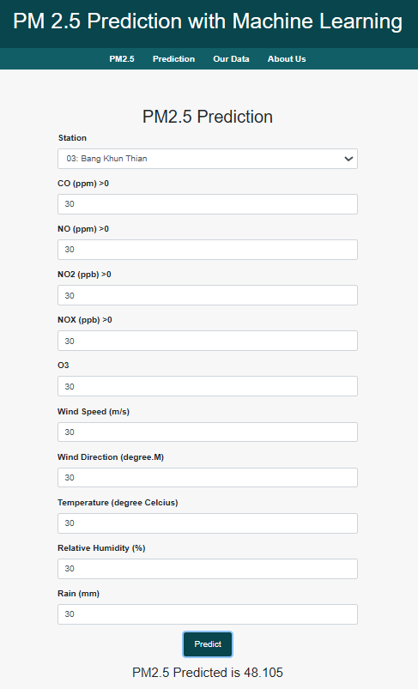
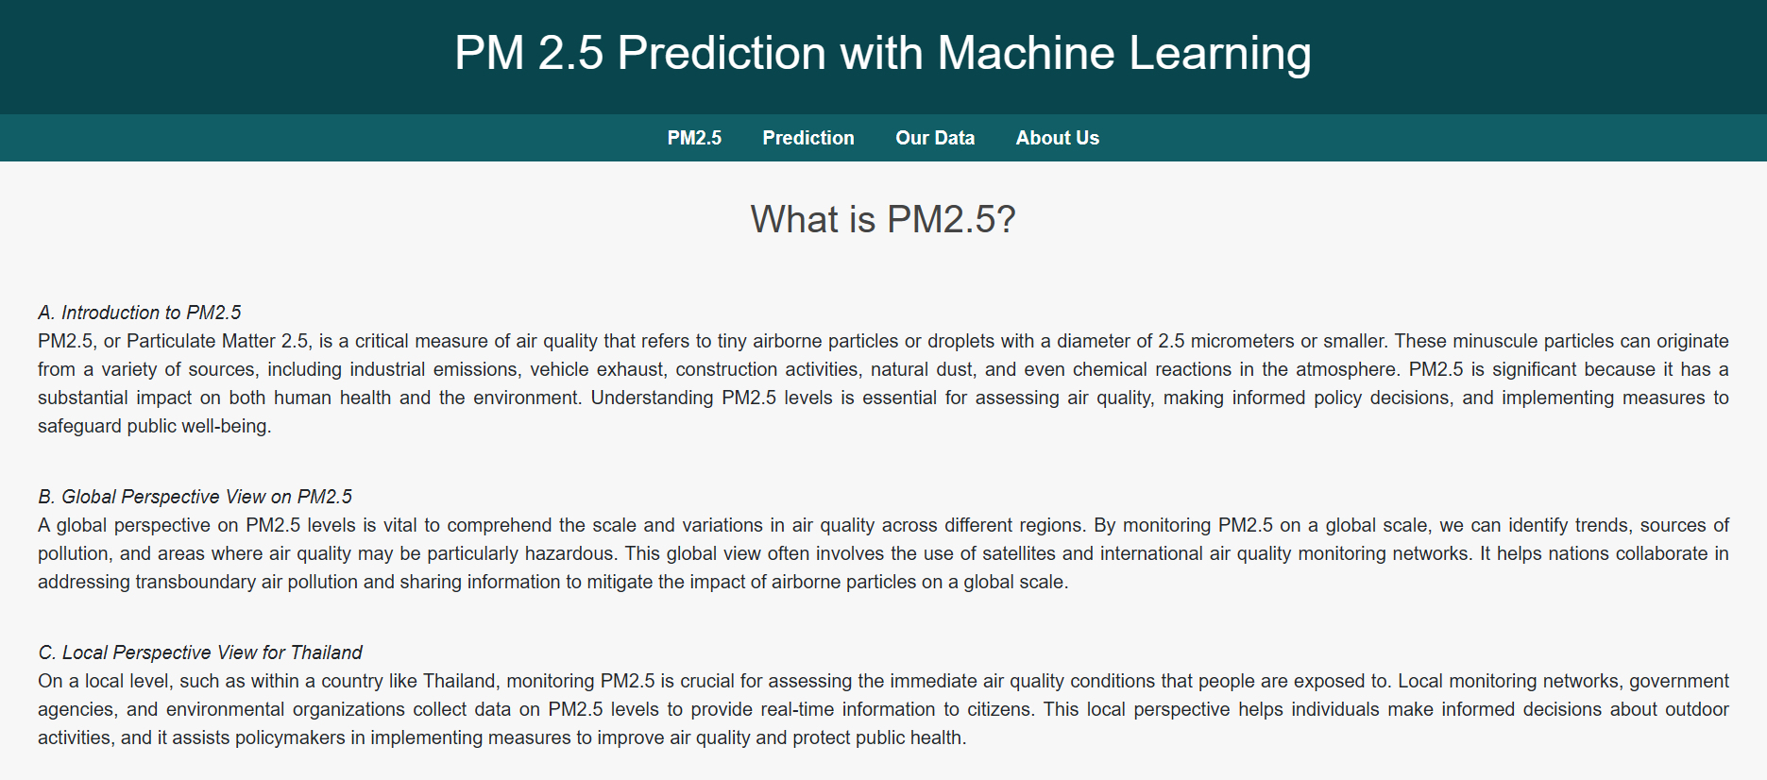
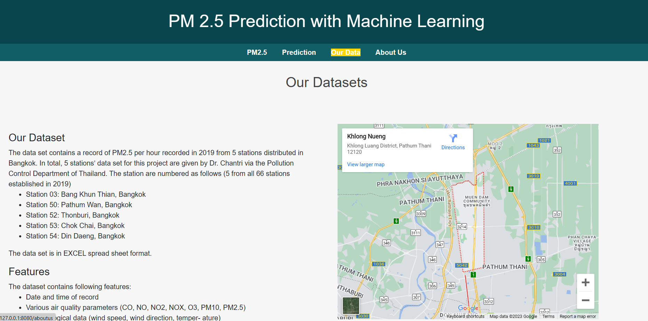
Results
01
Web Application in local host
02
Prediction
03
04
PM2.5 Info
05
Project Info
Image Source:

Slide 31

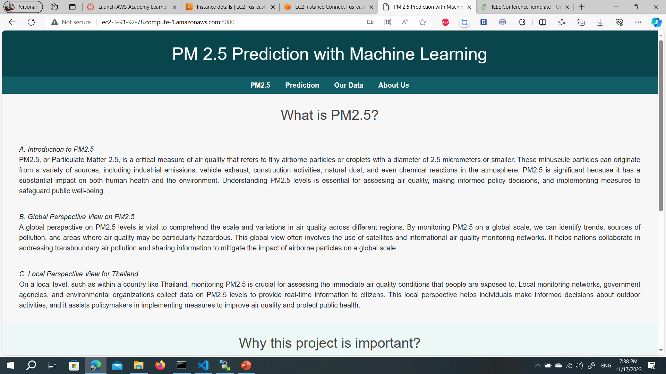
Results
01
Deployment in
02
03
04
http://ec2-54-80-52-153.compute-1.amazonaws.com:8080/
05
INSERT AWS link to demonstrate
Show image and zoom on URL that can access globally.
Image Source:

Slide 32
Conclusion & Future Works
01
02
03
04
05

Slide 33
Conclusion
01
02
The main benefit of this project is predicting the PM2.5 value based on given weather conditions, specializing scikit-learn library to create a machine learning model to achieve that task and deploying it to the website for end-users to use.
This model can also be used with other station data too, to further enhance the performance of the model, making it able to predict various data from other places.
03
04
05
Image Source:

Slide 34
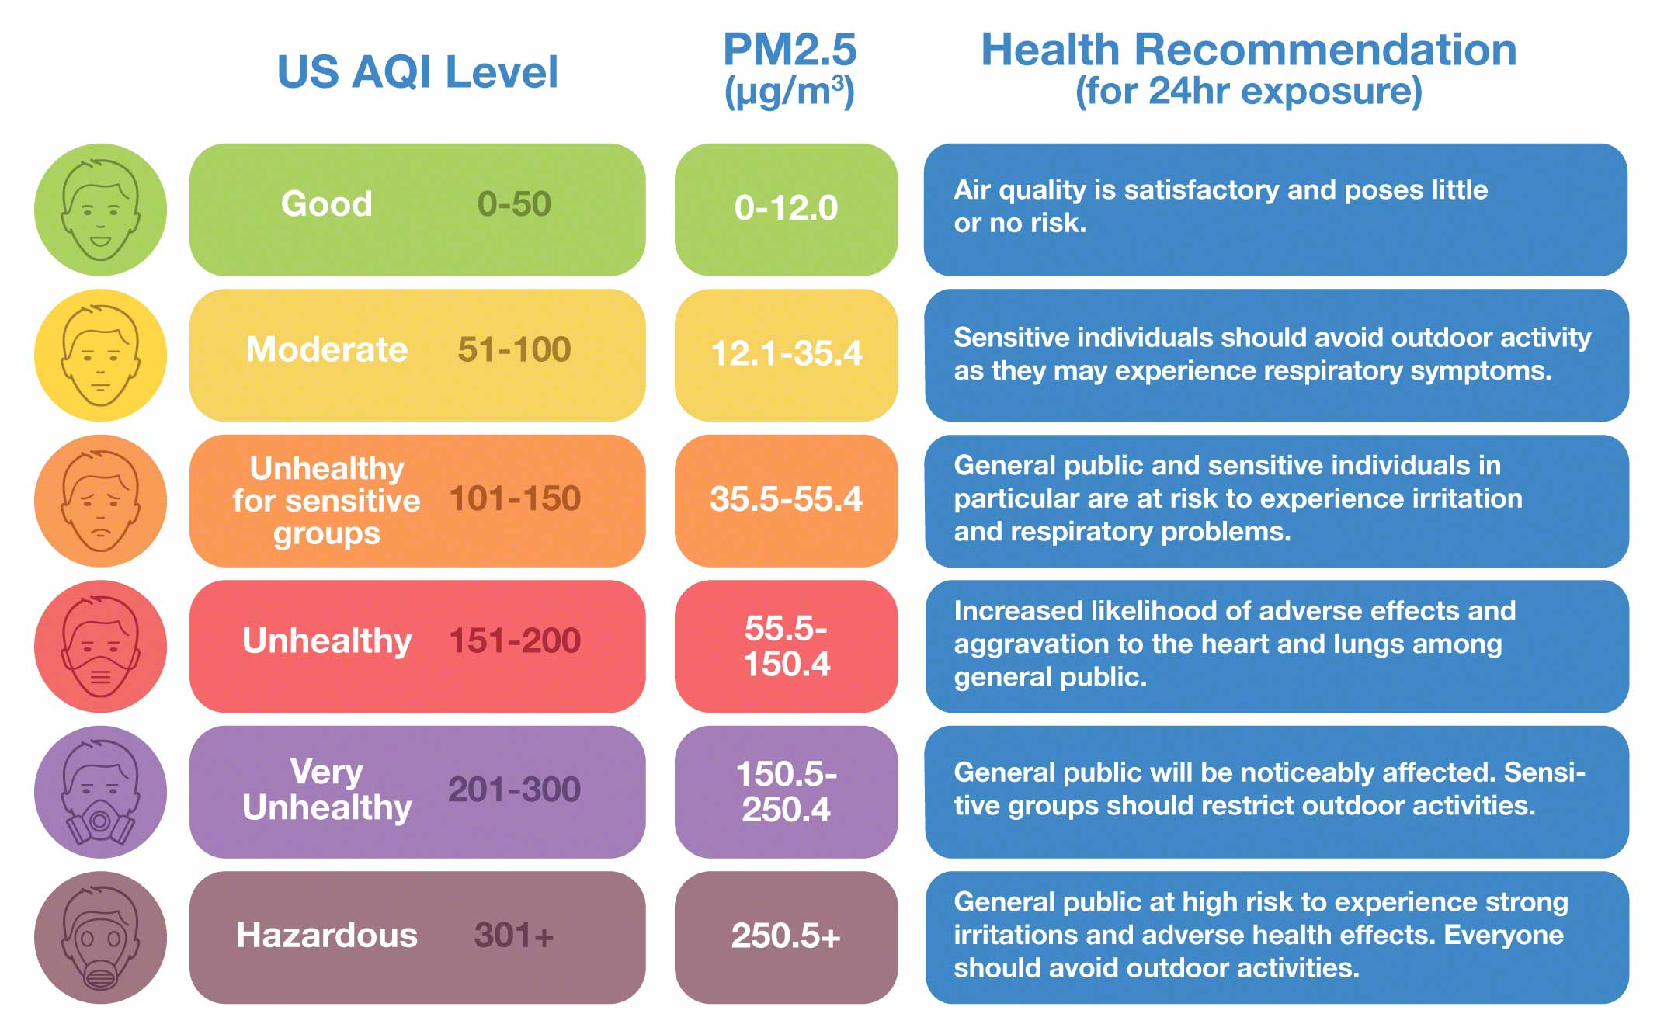
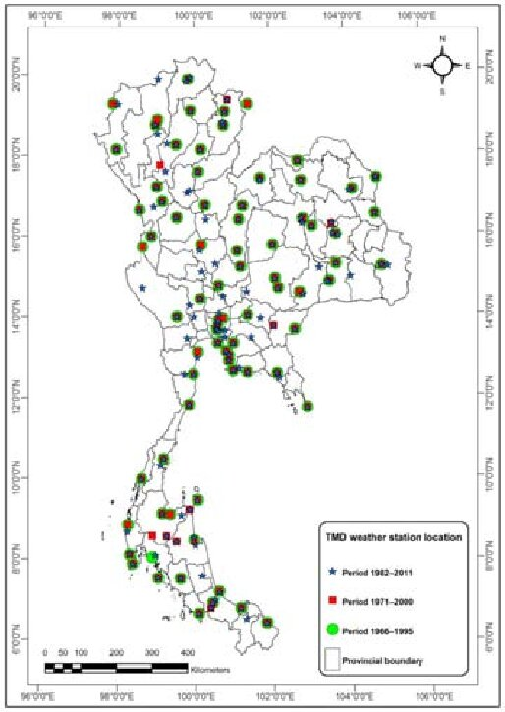
Future Works
Time-series Analysis
since the problem can be involved forecast with timestamp.
Air Quality Index
giving the users know more on how should they act and prepared (Decision-Making)
Include More Data from Different Stations
In Thailand would give more in-depth details in PM2.5 data in Thailand will strengthen the model further in predicting PM2.5 in more diverged places
01
02
03
04
05
Image Source: https://www.researchgate.net/publication/294670317_Comparison_and_Recalibration_of_Equations_fo r_Estimating_Reference_Crop_Evapotranspiration_in_Thailand/figures?lo=1

Slide 35
Deployment

Slide 36


Slide 37

แนวทางการออกแบบระบบใบพัดต้นแบบ
Loop Design 1
ใบพัด Rectangular NACA0012
Loop Design 2
ข้อมูล Versar
เลือก Twist
เลือกลักษณะปลายใบพัด
เลือกค่า Taper
ดูช่วงของ Reynolds number
ออกแบบส่วนที่ยึดใบพัด
เลือกความยาว Chord
เลือกแพนอากาศ
ขั้นตอนการผลิต
Y
Tip Chord > 5 cm
Planform ที่เลือกเหมาะสมกับแพนอากาศ
N
Y
N
Notes:
ตรง process วนลูป เลือก 0.55 c9 เพราะปรึกษากับช่างแล้ว ว่าทำได้

Slide 38
แนวทางการออกแบบระบบใบพัดต้นแบบ
Loop Design 1
ใบพัด Rectangular NACA0012
ข้อมูล Versar
Loop Design 2
เลือก Twist
เลือกลักษณะปลายใบพัด
เลือกค่า Taper
ดูช่วงของ Reynolds number
ออกแบบส่วนที่ยึดใบพัด
เลือกความยาว Chord
เลือกแพนอากาศ
ขั้นตอนการผลิต
Y
Tip Chord > 5 cm
Planform ที่เลือกเหมาะสมกับแพนอากาศ
N
Y
N
Notes:
ตรง process วนลูป เลือก 0.55 c9 เพราะปรึกษากับช่างแล้ว ว่าทำได้

